Slide 1

Process & Service Design Project
Prof. Plebani
Sara Limooee, 10886949
Behdad Nemati, 10879495
Mohammad Hosein Behzadifard, 10880732

Slide 2
Project Description
2. Open API Specification & Mock-up
3. Models
4. Running on Camunda
01
02
Table Of Contents
03
04

Slide 3
1. Project Description

Slide 4

House Renovation Company (HRC)
This project is an e-service for a house renovation company(HRC) that can handle renovation requests and communicate with other 3rd parties easier.
User sends a renovation request to HRC and it will then check its feasibility. If feasible, based on the request, HRC will contact any of the 3rd parties(plumbers, electricians or constructors) required for the project.
The process will:
Begin as soon as a house holder sends a new renovation request is sent to the HRC.
Finish if the request is not feasible or the renovation is completed.

Slide 5
Process
House holder ask for renovation
HRC check request feasibility
HRC ask for quotation to all 3rd parties
HRC select the best ones (winner 3rd parties)
HRC inform winners
HRC waits for work to finish
HRC inform householder when the project is finished
STOP
STOP
Not feasible
feasible

Slide 6
2. Open API Specification & Mock-up

Slide 7
Open-API Specification
Plumber.yaml
RequestForQuotation [post]:
Receives a new request for quotation from a HRC company and responds with a Quotation
Project [post]:
Request to start a project
Project [get]:
Gets completion status of the project by Id

Slide 8
Open-API Specification
Constructor.yaml
RequestForQuotation [post]:
Receives a new request for quotation from a HRC company and responds whether the request was submitted or not
RequestForQuotation [put]:
Receives a request for editing the quotation request with specific id from a HRC company and responds whether the request was submitted or not
RequestForQuotation [delete]:
Receives a request for deleting the quotation request with specific id from a HRC company and responds whether the quotation was deleted or exception happened.
RequestForQuotation [get]:
Receives a request for offering the quotation of the request for quotation with specific id from a HRC company and responds with the Quotation.
Project [post]:
Request to start the project
Project [get]:
Gets completion status of a project by Id

Slide 9
Open-API Specification
Electrician.yaml
RequestForQuotation [post]:
Receives a new request for quotation from a HRC company and responds whether the request was submitted or not
RequestForQuotation [put]:
Receives a request for editing the quotation request with specific id from a HRC company and responds whether the request was submitted or not
RequestForQuotation [delete]:
Recives a request for deleting the quotation request with specific id from a HRC company and responds whether the quotation was deleted or exception happened.
Project [post]:
Request to start a project

Slide 10
Mock-up
In this phase, a very general mock-up of the services is implemented using C#.
1) Open-API description of the services are described in a yaml file.
2) Mock-up of the defined service is implemented.
In this phase, an individual yaml file is written for each 3rd parties, explaining their restful APIs, considering the fact that the communication between each of the 3rd parties and the HRC is as follows:
1) Plumber offers a synchronous API to HRC.
2) Electrician offers an asynchronous API to the HRC, in turn the HRC also offers an asynchronous API to this company.
3) Constructor offers an asynchronous API to the HRC.

Slide 11
3. Models

Slide 12
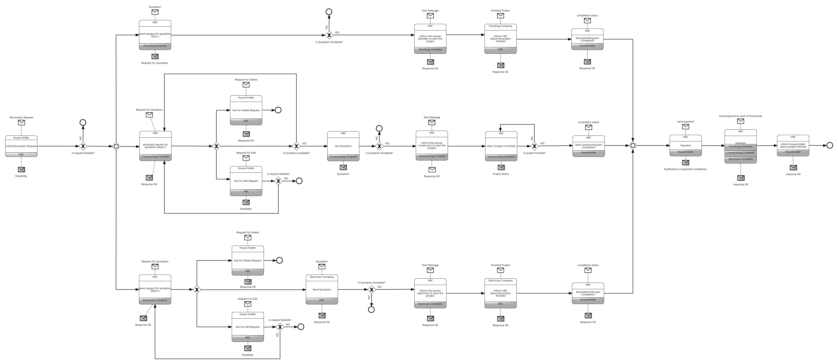
Choreography Model

Slide 13
BPMN Model

Slide 14
Executable Model

Slide 15
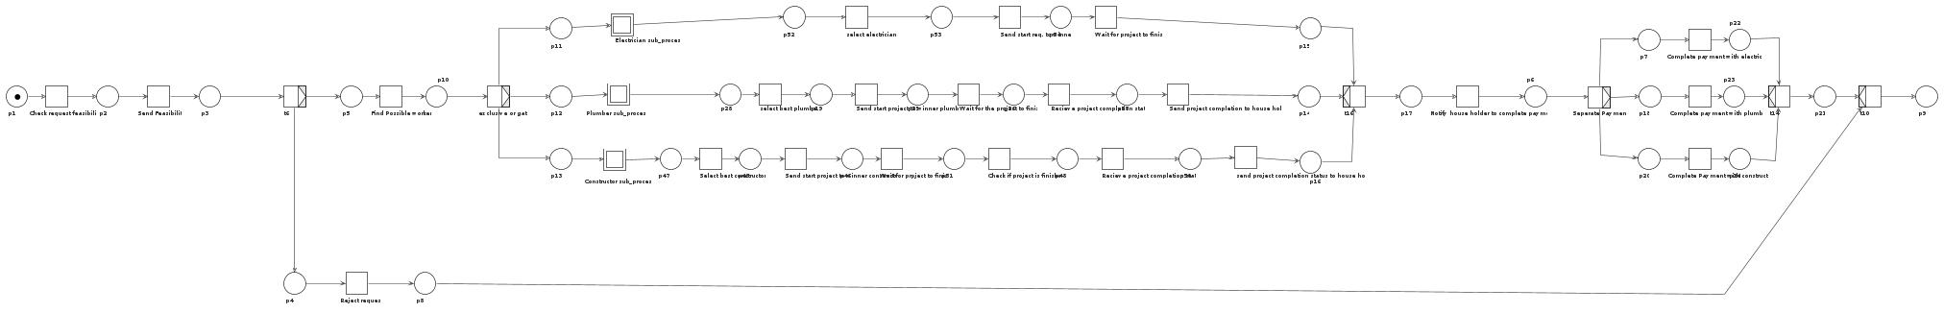
Petrinet

Slide 16
4. Running on Camunda

Slide 17
Modified Executable Model

Slide 18
Thank you for your attention

